Slide 1
TRUVEN HEALTH ANALYTICS
MARKETSCAN® RESEARCH DATABASES, PART I
Custom Data Analytics

Slide 2
AGENDA
Introductions
Overview of the MarketScan Research Databases
Strengths and limitations
Speciality databases
Questions and discussion

Slide 3
PAYER DATABASES
MarketScan® Commercial Claims and Encounters Database
Contains healthcare coverage eligibility and service use of active employees, early retirees, COBRA continuees, and dependents insured by employer-sponsored plans
MarketScan® Medicare Supplemental Database
Contains healthcare coverage eligibility and service use of Medicare-eligible retirees with employer-sponsored Medicare-Supplemental plans
MarketScan® Medicaid Multi-State Database
Healthcare service use of Medicaid enrollees from multiple states

Slide 4
SPECIALITY DATABASES
Specialty databases that can be linked to MarketScan® claims databases:
MarketScan® Health and Productivity Management (HPM) Database
MarketScan® Health Risk Assessment (HRA) Database
MarketScan® Lab Database
MarketScan® Dental Database
Specialty database linked to the MarketScan® claims databases via the client ID:
MarketScan® Benefit Plan Design Database

Slide 5
HOSPITAL DRUG DATABASES
MarketScan® Hospital Drug Database (HDD)
Contains inpatient discharges with detailed inpatient drug and procedure information
Inpatient Drug Link File
Links HDD to MarketScan Commercial and Medicare Databases

Slide 6
ELECTRONIC MEDICAL RECORDS DATABASES
MarketScan® Oncology EMR Database
Contains EMR for patients actively seen in 170 community oncology practices with nearly 800 contributing oncologists in the US
MarketScan® Oncology EMR-Claims Linked Database
Links Oncology EMR Database to MarketScan Commercial and Medicare databases
Quintiles EMR Database
Contains EMR for patients seen in primary care or specialty care offices
Linked Claims-Quintiles EMR Database
Links Quintiles EMR Database to MarketScan Commercial and Medicare databases

Slide 7
MARKETSCAN RESEARCH DATABASES
Payer Databases: Most recent three-year counts
Commercial (under 65) | 82M lives
Medicare Supplemental | 6.6M lives
Multi-state Medicaid | 14M lives
Specialty-Payer Databases: Most recent three-year counts
Health and Productivity Management | 6M lives
Health Risk Assessment | 2.5M lives
Lab Results | 4.9M lives
Dental | 12.3M lives
Benefit Plan Design | 7.2M lives
Hospital Databases
Hospital Drug | 13.9M discharges 2011-2015
Inpatient Drug Link | 926K matched admissions 2002-2015
EMR Databases (Not externally licensed)
EMR-Claims Link | 2.1M matched patients 2004-2013
Oncology EMR | 1.2M lives (January 2011-June 2015)
Notes:
7

Slide 8
OVERVIEW OF CLAIMS-BASED PRODUCT LINE
Content
Fully adjudicated and paid claims
Integrated enrollment, inpatient, outpatient and drug data
Includes carve-out services, drug mail order, injectables
Includes all plan designs (i.e. FFS, HMO, PPO, etc.)
Coverage
Entire US for Commercial and Medicare Supplemental
12 states in Medicaid
Over 158 million lives represented
History
Data available from 1996 forward

Slide 9
MARKETSCAN SOURCES
Contributors are Truven Health Analytics clients
Payers, e.g., self-insured employers and Medicaid states
Over 279 employers in the most recent 3 years, ~75% of MarketScan claims populations
Payers direct their carriers (over 345 unique carriers from national to local plans) to submit data to MarketScan
Health Plans
Approximately 26 plans, ~25% of MarketScan claims populations
Typically regional plans, e.g., BCBS
Plans submit data directly to MarketScan
Contributors release data to MarketScan in exchange for benchmark reports

Slide 10
MARKETSCAN BUILD – ADVANTAGE SUITE
Data collection and standardization start with Advantage Suite (AS)
Advantage Suite is a data warehousing/decision support product
Allows payers and plans to organize and analyze their covered populations’ claims data
Each contributor (e.g., single employer or Medicaid state) has its own AS server
All data contributors load data into AS

Slide 11
DATABASE CONSTRUCTION PROCESS
Eligibility
Claims
Encounters
Prescription Drug
Health & Productivity
Management,
Health Risk Assessment,
Lab, etc.
Carriers
(health plans,
prescription benefits
managers
etc.)
Advantage Suite
Payer/Client

Slide 12
DATABASE CONSTRUCTION PROCESS
Advantage Suite
Truven Health MarketScan Research Databases
Commercial Claims
Medicare Supplemental
Medicaid Multi-State
Laboratory
Health & Productivity Management
Health Risk Assessment
Dental
Advantage Suite
Advantage Suite
Advantage Suite

Slide 13
BUILDING MARKETSCAN
Advantage Suite
Claims
Encounters
Enrollment
Providers
Privacy Protection
Integration
Standardization
Customization
Data
Extract
Privacy Protection
Ensuring confidentiality and privacy of client data
Integration
Combining data from different sources or formats to create the database
Standardization
Making key variables consistent across all data sources
Customization
Structuring the databases to meet the client’s analytical needs
Patient identifier encryption
Access restrictions on need to have basis
Data center processes & controls
Multiple claim / encounter systems
Eligibility data
Capitation data
Carve-out vendors: drug, MH, etc.
Financial fields
Service categories
Member relationships
Geographic regions
Age groups
Other demographics
Account groups
Product lines
Enrollment categories
Member categories
Other data enhancement

Slide 14
BUILDING MARKETSCAN
Advantage Suite
MarketScan Data Mart
Claims
Encounters
Enrollment
Providers
Enhancement
Quality Assurance
Improvement
Privacy Protection
Integration
Standardization
Customization
MarketScan
Data
Extract
Enhancement
Adding value to the data using standardized methodologies
Quality Assurance
Assuring that the database accurately reflects what occurred
Improvement
Improving the quality and uses of the data over time
Admissions and episodes
Inpatient Admissions Summary
Medical Episode Grouper
Clinical groupings:
MDCs & DRGs
Drug Classification
National weight keys
Financial and record count reconciliation
Accuracy (valid values, patterns of coding)
Completeness (missing fields, missing records)
Reasonableness (admit rates, ages, per capita $)
Increasing the number of contributors
Better provider information
Adding data elements
Improvement plans with suppliers
Integrating new data sources

Slide 15
KEY QUALITY CHECKS
Reasonableness of data: Ensures that distribution of data elements are reasonable against norms
Financial and Utilization Rates are calculated. Plans greater than 10x off the median for that data type (FFS, Encounter, Commercial, Medicare) are dropped
Testing for relative quantity of positive, zero, and negative financials
Medicare data are tested for payments distribution (COB field) to ensure we are capturing the Medicare payment
Validity: Ensures selected fields are valid
Relative distribution of categorical variables (i.e. Provider Types)
Tests for acceptable levels of medical, drug, and MHSA coverage indicators
Tests for non-standard values of standard fields (e.g., place, service type)
Completeness: Data collected are as close to 100% as possible
Claims lag is 6 months for annual files and 3 months for quarterly updates
Testing for data completeness occurs at the client-plan level
Testing for data completeness by quarter for medical and drug claims

Slide 16
KEY QUALITY CHECKS
Additional enhancement examples:
Integration of benefit plan characteristics, enrollment, outpatient pharmaceutical claims, and medical/surgical data
Creation of a common synthetic patient identifier to link files and ensure patient confidentiality
Hospital data
Coding and consistency checks at the record and discharge level
Error threshold and check for unusual monthly changes
Case-mix analysis at the hospital level
Year-to-year trend outliers

Slide 17
MARKETSCAN COMMERCIAL DATABASE
Years | Commercial Patients
Last 3 years (2012-2014)* | 82.4M
Under 65 working population & their dependents
Inpatient and outpatient medical claims linked to drug, person-level enrollment, and benefit plan design data
Fee-for-service and fully/partially capitated plans represented
Indemnity plans (FFS)
Preferred provider organizations (PPOs)
Point of service plans (POS)
Health maintenance organizations (HMOs)
*Plus quarterly updates through Q2 2015
Projectable to the U.S. population covered by employer-sponsored insurance

Slide 18
MARKETSCAN MEDICARE SUPPLEMENTAL DATABASE
Years | Medicare Supplemental Patients
Last 3 years (2012-2014)* | 6.6M
Includes Medicare supplemental and coordination of benefits (COB) for retirees covered by their previous employers
Inpatient and outpatient Medicare supplemental medical claims, linked to drug, person-level enrollment, and benefit plan design data
Both the employer-paid and Medicare-paid components of care represented
Projectable to the U.S. population with Medicare supplemental insurance
15.3 million retirees
*Plus quarterly updates through Q2 2015
Notes:
12.7M is based on MEPS data.
Through Q4 2008

Slide 19
MarketScan Standard Releases
Two standard products for Commercial and Medicare Supplemental
Annual Updates (v1.0) released in December each year for preceding year
Best use: Need fully-paid and adjudicated claims for complete calendar year
Standard Quarterly Updates (SQUs) released in four 3-month periods
2011 Q1/v01 shipped with 2010 Annual Update 1.0 in Dec.
Each SQU replaces the prior shipment
Best use: Need most recent fully-paid and adjudicated claims
Provide access to all drug, professional, facility, and inpatient data from paid, adjudicated claims

Slide 20
MARKETSCAN EARLY VIEW DATABASE
Provides access to all drug, professional, facility, and inpatient data available
60-day lag between service date and date of data release
Brings in all contributors/data available up until the creation date
Quarterly build that augments the Standard Update
Fully integrated, patient-centric, medical and drug claims database
Provides preview of data before all claim types have been paid (before complete run-off)
Best use: Monitoring patient uptake of drugs and linking prescription fills to medical utilization data
Drugs have a 99% completion factor as of the first month after a service date

Slide 21
MarketScan Databases: Run Off and Lag
Standard Releases | Incurred Dates (minimum) | Paid Through | Imposed runoff | Lag (date of availability - latest incurred date)
Final 2014 | 01/2014 - 12/2014 | 06/30/15 | 6 months | 12 months
Q1 2015 | 01/2015 - 03/2015 | 06/30/15 | 3 months | 9 months
Q2 2015 | 01/2015 - 06/2015 | 09/30/15 | 3 months | 9 months
Q3 2015 | 01/2015 - 09/2015 | 12/31/15 | 3 months | 9 months
Q4 2015 | 01/2015 - 12/2015 | 03/31/16 | 3 months | 9 months
Final 2015 | 01/2015 - 12/2015 | 06/30/16 | 6 months | 12 months
Q1 2016 | 01/2016- 03/2016 | 06/30/16 | 3 months | 9 months

Slide 22
CHOOSING THE RIGHT MARKETSCAN DATA RELEASE
Healthcare services are processed and paid at different rates
Drug claims are paid quickly reaching 99% after one month, while other claims take longer
The most recent month of claims in any dataset will be less complete compared to earlier months contained in the dataset

Slide 23
MARKETSCAN MULTI-STATE MEDICAID DATABASE
Years | Medicaid Database Patients
Last 3 years (2012-2014) | 14M
Pooled Medicaid data from 10-13 geographically dispersed states
Includes Medicaid managed care plans
Inpatient services and prescription drug claims, plus information on enrollment, long-term care, and other medical care
Additional variables
Race
Medicaid eligibility category
Medicare eligibility

Slide 24
Strength and limitations of MarketScan databases

Slide 25
MAJOR ADVANTAGES OF MARKETSCAN CLAIMS DATA
Large sample size
Projectable to the U.S. population covered by employer-sponsored insurance
Strong longitudinal data
Ability to track patients over multiple years and health plans
Strength of employer-based dataset is ability to “retain” patients when they switch health plans
Data linked at the patient level by a unique identifier that is consistent across services, health plans, time
Fully paid and adjudicated claims

Slide 26
MAJOR ADVANTAGES OF MARKETSCAN CLAIMS DATA
Detailed prescription drug Information
Complete outpatient prescription drug information including patient copayments, mail order, injectables, specialty pharmacies, most carve-outs, manual and electronically submitted claims, plan summaries
Drug use in outpatient setting
For a subset of patients, drug use in the inpatient setting
Reflects the true continuum of care
Fully integrates all treatments and plan design
Continuum of care in all settings:
physician office visits;
hospital stays;
retail, mail order, and specialty pharmacies; and
carve-out care services
Provides understanding of impact of cost, treatment, and behavioral drivers

Slide 27
LIMITATION OF MARKETSCAN CLAIMS DATA
Data are not reflective of the entire US population. MarketScan Research Databases include individuals with private insurance, Medicare supplemental insurance, Medicare Managed Care, and Medicaid
Does not include the uninsured, cash payers, and Medicare beneficiaries (not MMC) without supplemental insurance
The majority of Commercial and Medicare data are from large, self-insured employers
MarketScan Medicaid Database does not include all states
States vary in eligibility requirements and covered services

Slide 28
LIMITATION OF MARKETSCAN CLAIMS DATA
MarketScan Commercial, Medicare, and Medicaid are administrative claims data
Claims include information on diagnoses and services performed
Undiagnosed conditions will not be captured
Lifestyle and biometric factors (i.e. smoking status, BMI) are not well-captured in claims data
Only a subset of the population who are present in the link Lab database have lab results
Services covered under long term disability and provided during long term care may not be captured
Medicaid geographic identifiers are for internal use only and not available for reporting
There are contractual restrictions in reporting region below the MSA level for Commercial and Medicare populations
All MarketScan databases are HIPAA compliant and de-identified, and as a result, MarketScan individuals cannot be linked to external data sources such as registries

Slide 29
LIMITATION OF MARKETSCAN CLAIMS DATA
Some services may not be captured in MarketScan
Services covered 100% by primary payer (MarketScan contributor) are captured in MarketScan
Services covered by primary payer (MarketScan contributor) and secondary payer, the secondary payer amount is captured under coordination of benefits
Services covered 100% by the secondary insurer are not captured in MarketScan
Reimbursement policy may affect what is captured in MarketScan
For patients with private Medicare supplemental insurance and dual Medicare-Medicaid coverage, services that may not be captured include:
Inpatient readmissions (for the same condition)
Skilled Nursing Facility (first 21 days following hospitalizations)
Beginning in 2006, the Medicaid database does not capture prescription coverage for patients with dual Medicare-Medicaid coverage

Slide 30
DRUG COVERAGE FOR MARKETSCAN MEDICARE POPULATION
MarketScan Medicare population receive employer-sponsored drug coverage
Employers offer ‘creditable coverage’ and receive a federal subsidy
Creditable coverage means that the plan would pay at least as much as Part D in the aggregate over all Medicare eligible
Over 99% of MarketScan Medicare beneficiaries had drug coverage in 2005
This coverage dropped to 98.7% in 2006
Employers contributing to MarketScan Medicare Database did not move their beneficiaries to Part D

Slide 31
Speciality databases

Slide 32
MARKETSCAN HEALTH AND PRODUCTIVITY MANAGEMENT (HPM) DATABASE
Years | HPM Employees
Last 3 years (2011-2013) | 6M
Used to quantify the total burden of illness (indirect and direct costs) and calculate employer-based demand management initiatives
Linked medical, drug, enrollment, absenteeism, short-term disability, long-term disability and workers’ compensation data
Suitable for studies to examine productivity loss of employees as patients or as caregivers (patients as spouse or dependent)
Data available 1997-2013
HPM 2012
Absence data for 757K employees
Short-term disability data for 4.15M employees
Long-term disability data for 4.1M employees
Worker’s compensation data for 2M employees
Notes:
From Laura Christian: The most recent three years covers 6,057,482 employees. (Email on 2/20/2015)

Slide 33
MARKETSCAN BENEFIT PLAN DESIGN (BPD) DATABASE
Year | BPD Lives
Last 3 years (2011-2013) | 8.6M
Detailed data about benefit plan characteristics, linked to medical claims, for a subset of the population in the Commercial and Medicare Databases
Includes information on exclusions, limitations, deductibles, precertification requirements, and pharmacy coverage, when available
Formularies are not released
Information abstracted from summary plan description booklets received by employers
Available 1996-2013

Slide 34
MARKETSCAN LAB DATABASE
Years | Linked Lab Patients
2004-2015 | 9M
Healthcare researchers use these data to understand how well a drug is performing in the real-world clinical setting by looking at lab test results
Inpatient, outpatient, prescription, and enrollment data are available for all patient lives

Slide 35
MARKETSCAN HEALTH RISK ASSESSMENT (HRA) DATABASE
Patient-reported health behaviors and clinical data linked to claims data
Standardized HRA data combined with claims yield innovative research opportunities
Key targets for research
Completes the full health and productivity picture along with claims, absence, short-term disability, and worker’s compensation data
Years | HRA respondents
2003-2014 | 3.5M
Potential Study Areas
Obesity
Cardiovascular disease
Metabolic syndrome
Smoking cessation
Alcohol consumption
Insomnia
Notes:
From Laura Christian: The HRA file includes all responses from 2003 to 2014. It includes 2,152,982 respondents in 2013-2014 and 3.6 million respondents in 2003-2014. (Email on 6/15/2015)

Slide 36
MARKETSCAN DENTAL DATABASE
Only integrated medical and dental database available
Includes Commercial and Medicare Supplemental patients (age 65+)
Unique as it includes dental claims for the elderly population
More than 80% of enrollees have potential pharmaceutical claims
Time Period | Linked Dental Patients
2005 – 2013 | 18.7M
Notes:
With MS
All Dental is 25.2M

Slide 37
MARKETSCAN HOSPITAL DRUG DATABASE
Used for research on drug and product utilization in the hospital setting
Hospital billing and pharmacy ordering system database
400 hospitals from 2002 – June 2015
Drug, diagnosis, and procedure
De-identified patient-level data
Projected regionally and nationally
Well-represented hospital sample
Data are standardization via proprietary clinical coding system
Each patient receives a severity score based on the Risk Adjusted Mortality Index (RAMI)
Years | Discharge records
2002 – 2015 | 71.7M

Slide 38
MARKETSCAN HOSPITAL DRUG DATABASE (OUTPATIENT)
Used for research on drug and product utilization in the hospital outpatient setting
Includes emergency room, 23-hour beds, same day surgery, hospital-based clinics
Hospital billing database
165 hospitals from 2004 - 2013
Drug, diagnosis, and procedure
De-identified patient-level data
Projected regionally and nationally
Well-represented hospital sample
Monthly updates
Years | Patient Registrations
2002 – 2015 | 502M
Patient demographics, payer, hospital characteristics, charges, physician specialty
All drugs administered during the visit
ICD-9-CM diagnoses, CPT-4/HCPCS procedures, APC procedure classifications
Database is used for analyses but not licensed externally
Notes:
38

Slide 39
MARKETSCAN INPATIENT DRUG LINK FILE
Years | Inpatient Drug Link
2002 - 2015 | 926,725 matched admissions
Linking claims and discharges
Assess the effects of an inpatient stay on drug utilization
Track details for the complete continuum of a patient’s care:
Longitudinal patient-level claims data
Linked with hospital inpatient drug data
Includes links to Commercial, Medicare, and Medicaid Databases

Slide 40
MARKETSCAN ONCOLOGY EMR DATABASE
Years | Linked EMR
2011 – Dec. 2014 | 109,823 matched patients (based on March 2015 update)
Sourced from 170 community oncology practices since July 2011 and updated quarterly
Contains patient history data prior to July 2011
Captures patient demographics, tumor type, stage, histology, treatment, and outcomes and other clinical information.
A subset is linked to Commercial and Medicare Databases
“Link” is done independently from the extract that we receive and may contain Oncology EMR patient identifiers for patients not in our EMR database

Slide 41
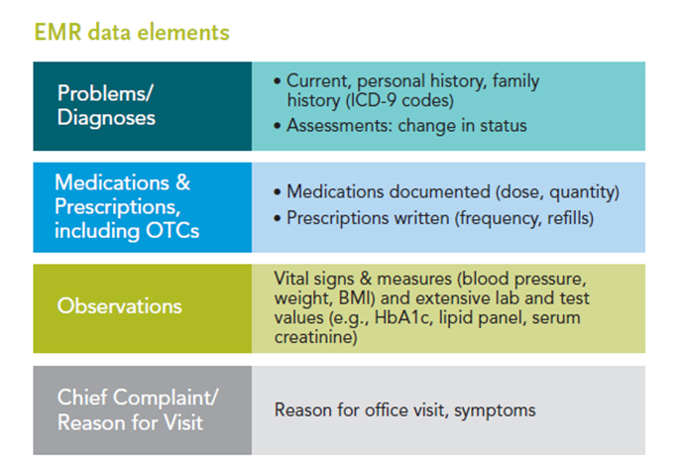
MARKETSCAN QUINTILES EMR DATABASE
Years | Linked EMR
2004 – 2013 | 1.7M matched patients (2004-2013)
Ambulatory medical records from >30,000 care providers
Includes links to Commercial and Medicare supplemental data
Linked claims and EMR data allow researchers to investigate situations where explanatory variables are not available in either dataset alone.
EMR clinical data can potentially improve condition identification.
Labs and vital signs
Longitudinal tracking of medical problems for patients

Slide 42
support

Slide 43
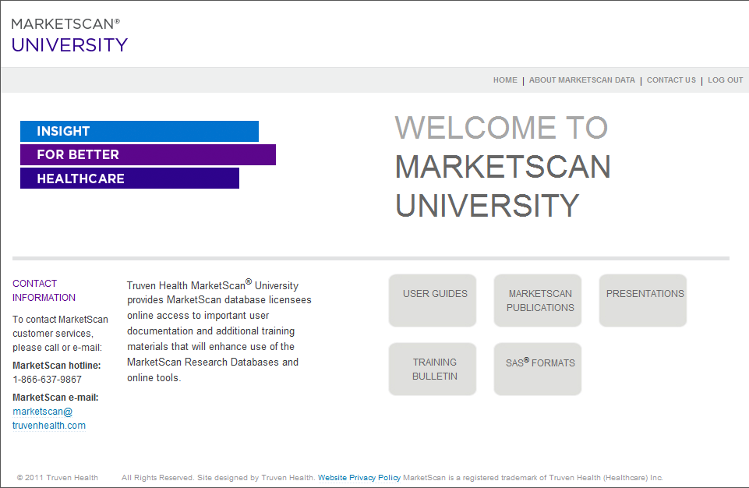
MARKETSCAN UNIVERSITY ONLINE
Quick access to materials to support your use of the MarketScan databases
Product support
Data dictionaries
User guides
Publications
Training bulletins
Bibliography
Trademark guidelines
Sample abstract text
Training
Web seminars
Posters
Location: https://marketscan.truvenhealth.com/marketscanportal/

Slide 44
SUPPORT
Laura Christian, Senior MarketScan Client Services Manager
Email: laura.christian@truvenhealth.com
David Hutchinson, Senior MarketScan Client Services Manager
Email: david.hutchinson@truvenhealth.com
Jody Quint, Sr. Director, Information Assets
Email: jody.quint@truvenhealth.com
MarketScan is a registered trademark of Truven Health Analytics, Inc.

Slide 45
Questions?

